Slide 1
New Mexico Provinces

Slide 2
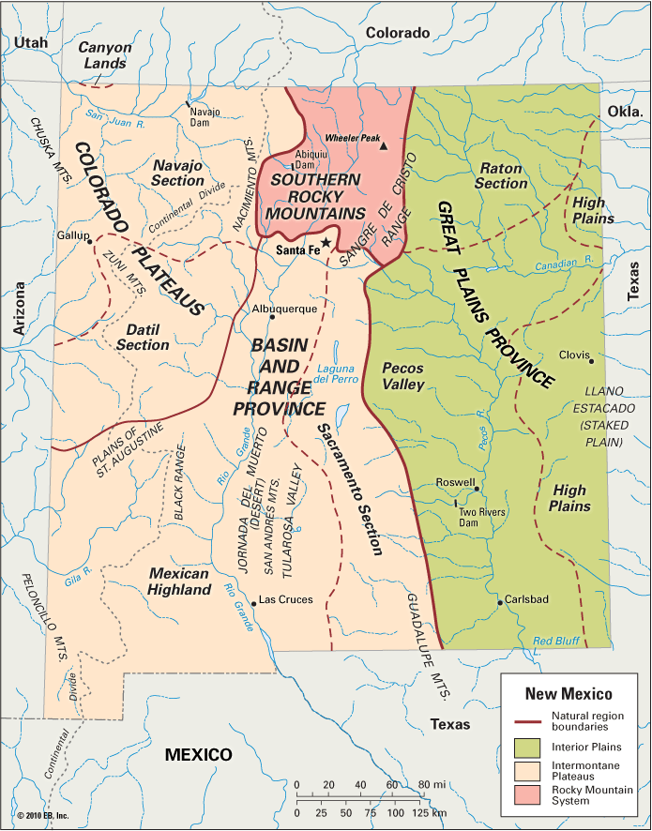
The Four Provinces in New Mexico
Rocky Mountains
Colorado Plateau
The Great Plains
Basin and Range

Slide 3
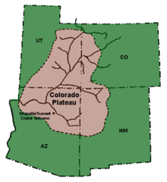
Colorado Plateau Province

Slide 4
Climate
Dry climate
Rain shadow effect

Slide 5
Plants and Animals
Plants: blackbrush, shadscale, grassy meadows and forests of quaking aspen
Animals: mice, rates, prairie dogs, gophers, squirrels, elk, mule deer, white-tailed deer, and mountain lions

Slide 6
Settlement Patterns
Home to about 70,000 Navajo Indians
The Navajo Nation is the largest Indian Reservation in the US
Farming and ranching
Mineral resources
Oil, gas, coal, and Uranium

Slide 7
Works Cited
Melzer, R., & Reyes, C. K. (2012). The New Mexico Journey. Layton, UT: Gibbs Smith Education.

